Slide 1

REPORT ON SEASONAL AND CYCLICAL PATTERNS IN MICROSOFT STOCK PRICES
Yeshwanth Gudise
M15886837

Slide 2
Introduction
This project analyzes seasonal and cyclical patterns in Microsoft’s stock prices.
Time series analysis is employed to uncover underlying patterns influencing stock movements.
Forecasting models evaluate accuracy in predicting Microsoft stock price trends.
The work focuses on analyzing corporate events impact on seasonal stock price behavior.
The project utilizes SARIMA and Holt-Winters models for financial forecasting evaluation.

Slide 3

Problem
Microsoft’s stock prices are influenced by complex factors, including corporate and market dynamics.
Seasonal and cyclical patterns remain underexplored in financial forecasting for Microsoft.
Inefficient forecasting models fail to capture periodic trends in stock price movements.
Investors lack tools to anticipate price movements linked to corporate event cycles.
Research addresses whether identifying patterns improves forecasting accuracy in Microsoft stock prices.

Slide 4
Research Questions:
What seasonal and cyclical patterns can be identified in Microsoft's stock prices using time series analysis?
How do these patterns align with Microsoft's corporate calendar, such as earnings reports, product launches, and major news events?
Can identifying these patterns enhance the accuracy of stock price forecasting models?

Slide 5

Solution
The solution involves identifying and modeling seasonal and cyclical price patterns using data analytics.
Seasonal Trend Decomposition using Loess (STL) separates Microsoft’s stock prices into trend, seasonal, and residual components.
Fourier Transform identifies periodicity to enhance the understanding of recurring price cycles.
SARIMA and Holt-Winters Exponential Smoothing models integrate these patterns into robust forecasting methodologies.
Models are evaluated for forecasting accuracy using Root Mean Squared Error (RMSE).

Slide 6
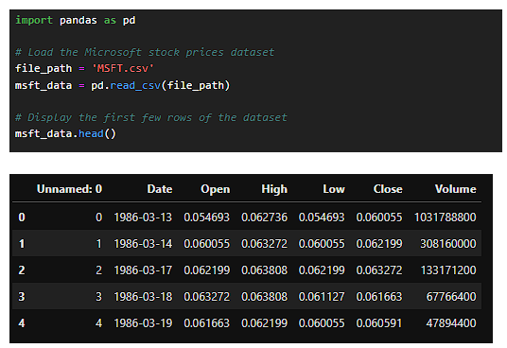
Demonstration: Data Preparation
Microsoft stock price data was collected, cleaned, and prepared for time series analysis.
Dates were converted to time indices with forward-filled missing values for continuity.
Stock closing prices were transformed for decomposition and Fourier analysis.
Seasonal patterns were visualized using STL decomposition, showing annual trends.
Data preparation ensured models could effectively detect periodic and trend-based behavior.

Slide 7
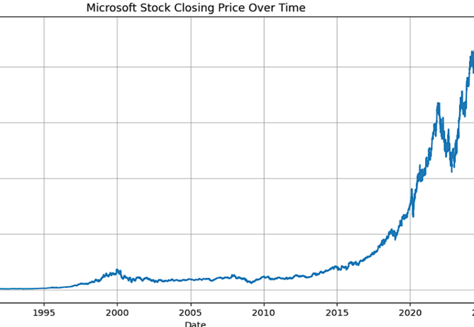
Demonstration: Identifying Patterns
Seasonal-Trend Decomposition (STL) revealed clear annual seasonality in Microsoft’s stock prices.
Seasonal components aligned with recurring corporate events like earnings and product launches.
Fourier Transform highlighted long-term cycles influenced by broader market dynamics.
Identified patterns were consistent with Microsoft’s corporate calendar of key events.
These insights informed the development of forecasting models for price prediction.

Slide 8
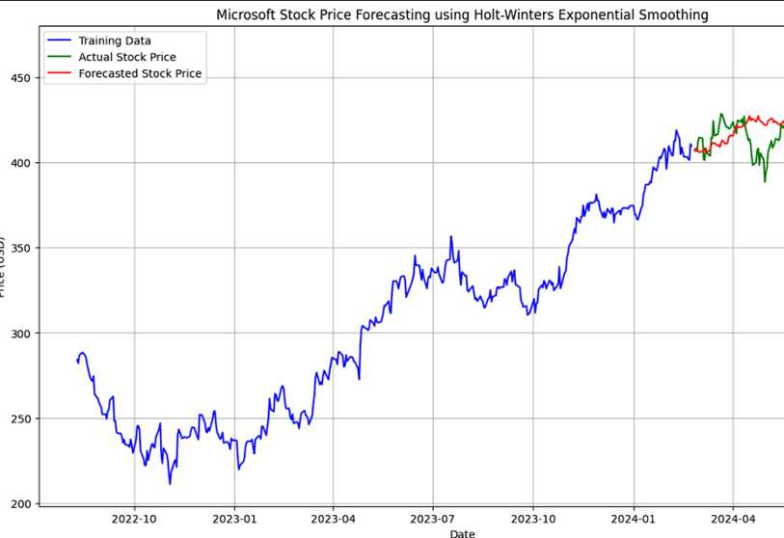
Demonstration: Forecasting Models
Seasonal ARIMA (SARIMA) incorporated trend, seasonal, and cyclical components for prediction.
Holt-Winters Exponential Smoothing captured both trend and seasonality in stock prices.
Models were trained using historical Microsoft stock price data spanning two years.
Forecast accuracy was measured using Root Mean Squared Error (RMSE) for comparison.
Outputs demonstrated clear alignment between seasonal components and stock price predictions.

Slide 9
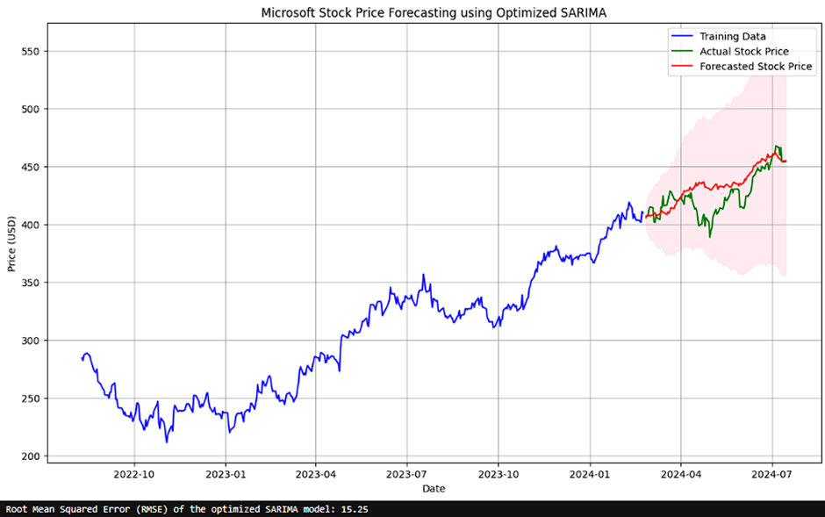
Demonstration: SARIMA Model Results
The SARIMA model demonstrated robust accuracy in forecasting stock prices over test periods.
Seasonal components improved prediction reliability, capturing recurring fluctuations in stock prices.
Cyclical patterns from Fourier analysis enhanced the SARIMA model's performance.
Forecasted values closely matched actual stock prices with minimal residual errors.
The SARIMA model achieved lower RMSE compared to other tested forecasting models.

Slide 10
Demonstration: Holt-Winters Model Results
Holt-Winters Exponential Smoothing effectively captured trend and seasonal variations in stock prices.
The model highlighted predictable changes in price driven by corporate event seasonality.
Forecast accuracy was reasonable but slightly inferior to SARIMA’s performance.
Larger residuals suggest the model struggled with cyclical patterns beyond seasonality.
RMSE indicated the need for advanced methods to capture longer-term stock price cycles.

Slide 11
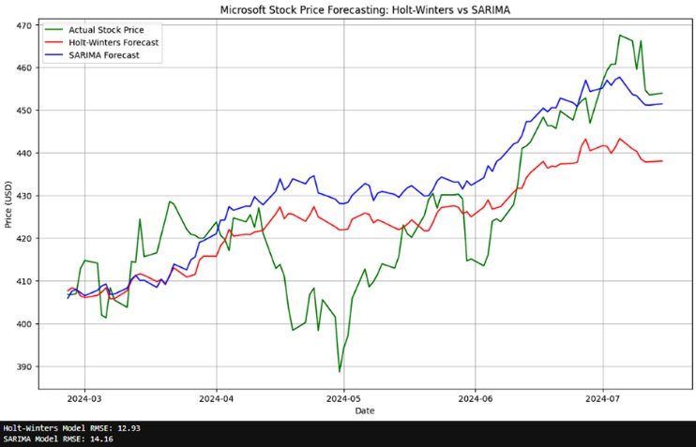
Comparative Analysis
SARIMA outperformed Holt-Winters Exponential Smoothing in forecasting Microsoft stock prices.
SARIMA’s RMSE was significantly lower, indicating better alignment with actual prices.
Holt-Winters lacked the sophistication to handle longer-term cyclical variations effectively.
Seasonal decomposition and Fourier analysis supported SARIMA’s accuracy and reliability.
Incorporating both seasonal and cyclical components proved essential for better forecasts.

Slide 12
Research Questions Addressed
Seasonal and Cyclical Patterns Identified: Clear annual seasonality and multi-year cycles were discovered.
Correlation with Corporate Events: Patterns aligned closely with earnings reports and product launches.
Forecast Accuracy: Identifying patterns significantly improved prediction accuracy using SARIMA.
Research confirmed that seasonal patterns improve actionable insights for investors.
Models validated the impact of recurring corporate events on stock price fluctuations.

Slide 13
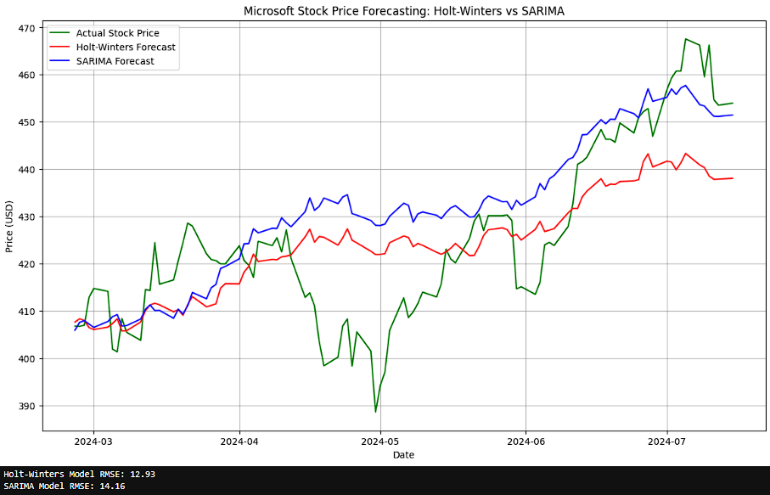
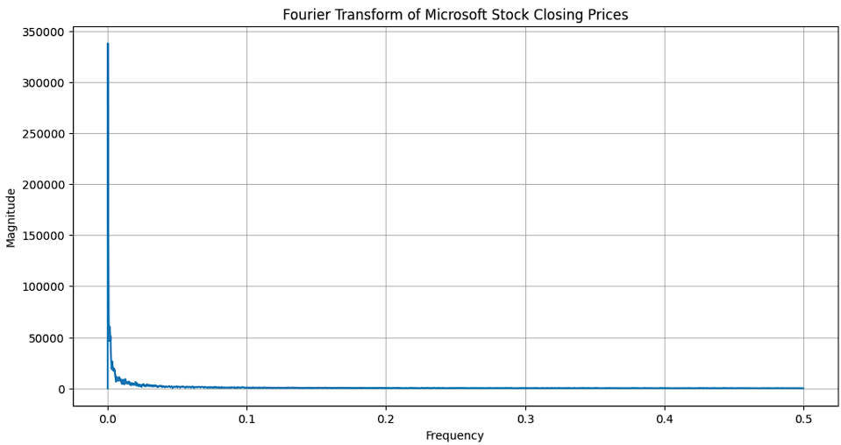
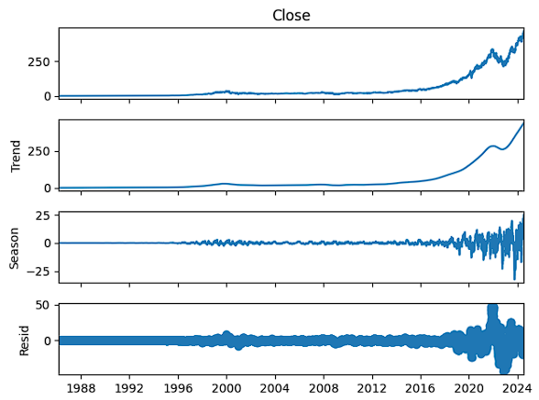


Results :

Slide 14
Implications and Significance
Findings contribute to financial forecasting by showcasing the role of seasonal stock patterns.
Investors can leverage models to make informed decisions on timing stock transactions.
Improved forecasts reduce uncertainty, enhancing confidence in investment strategies.
Study bridges the gap between stock price behavior and corporate event-driven cycles.
Results demonstrate that seasonality-aware models outperform traditional forecasting techniques.

Slide 15
Conclusion and Future Works
Seasonal and cyclical patterns are critical in improving stock price forecasting accuracy.
SARIMA effectively captured these patterns, outperforming Holt-Winters in prediction reliability.
Limitations include restricted focus on Microsoft and the influence of unforeseen market shocks.
Future research could explore other industries and enhance models for volatile market conditions.
Broader adoption of time series techniques can revolutionize financial forecasting practices.

Slide 16


